Slide 1
DSE 6220
Big Data
Hadoop & Spark
Week 7

Slide 2
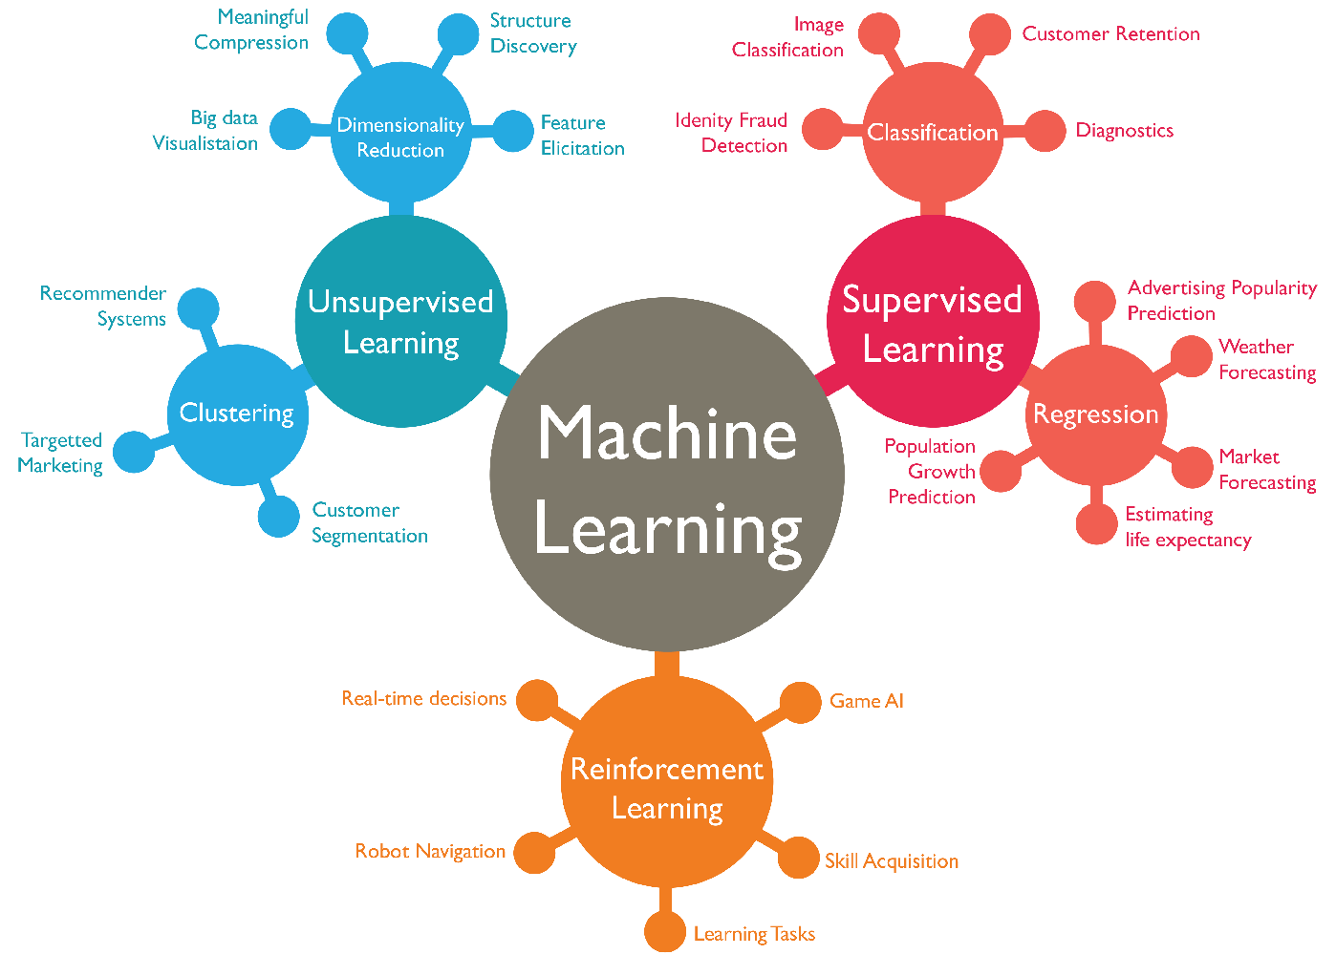
What is Machine Learning?
A process for extracting patterns form your data using statistics, linear algebra, and numerical optimization.
Supervised learning
Goal is to predict the output label
Unsupervised learning
Goal is to understand structure of data without a label

Slide 3
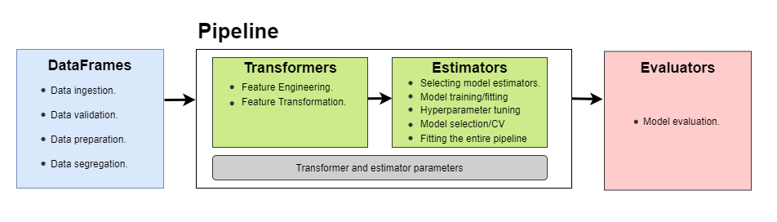
Spark ML Pipelines
Transformer
DataFrame input
Data is transformed based on a set of rules
Scaling/One-hot-encoding
DataFrame is returned
Estimator
Fits a model
Pipeline
Organizes a series of transformers and estimators into a single model

Slide 4
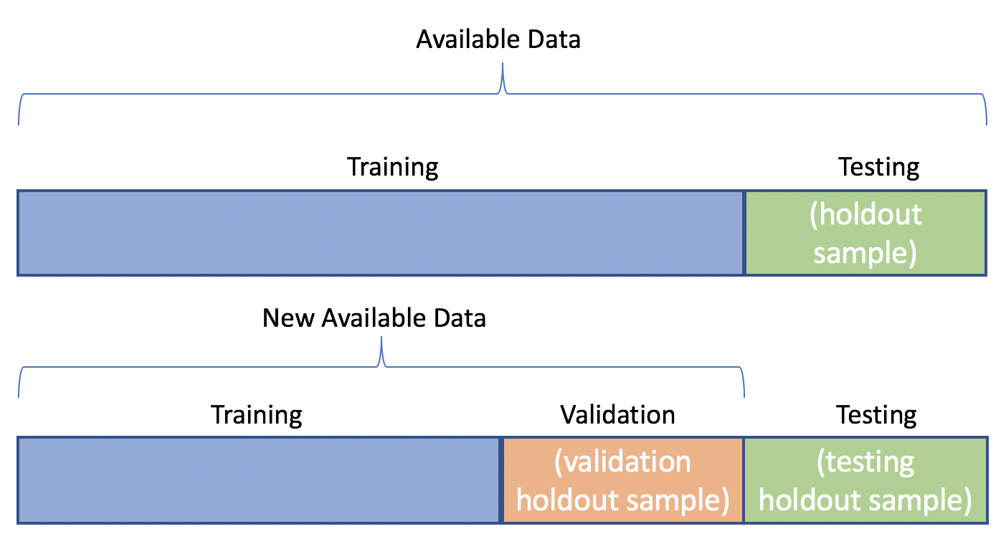
Train/Test Split
Goal is to split your input data into separate chunks in order to avoid overfitting
Tune for the bias variance tradeoff
Common splits include:
80/20
70/30
Need to ensure you have a balance of your labels in both splits!
Stratified splits
Example

Slide 5
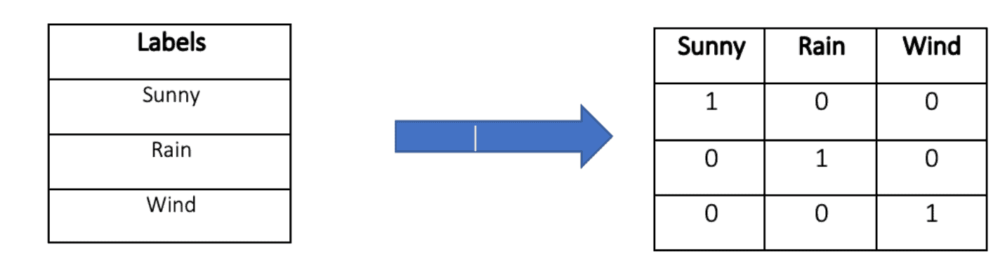
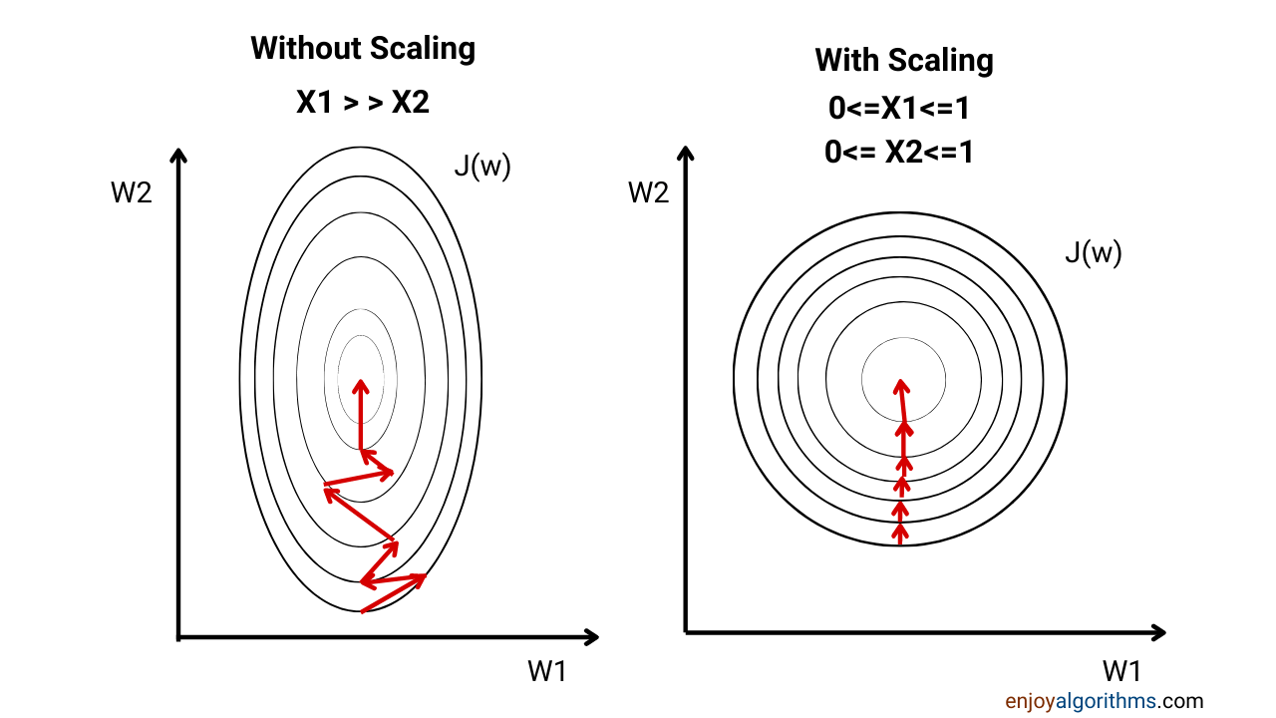
One-Hot-Encoding & Scaling
Transforms categorical features into numerical (binary) features
ML Algorithms cannot natively handle ‘categories’ or text, thus they have to be represented as numbers.
Numerical scaling is used to transform numerical features to a standardized scale in multi-variate scenarios.
Some ML algorithms are sensitive to large numerical differences between numbers which can skew your results

Slide 6
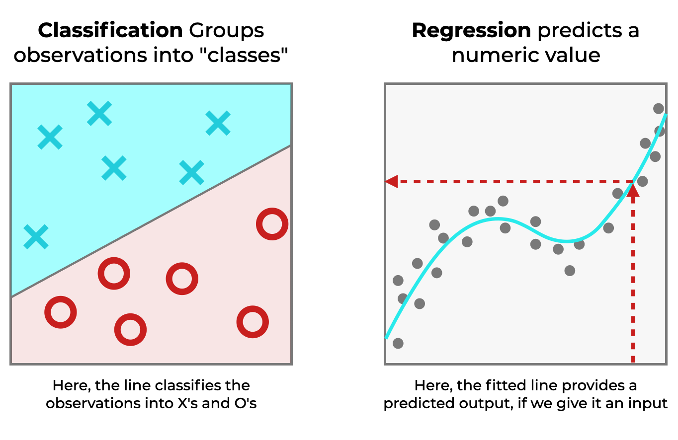
Classification Vs Regression
Classification
Regression
Sets of algorithms used to predict a categorical response
Examples:
1 = has cancer
0 = does not have cancer
Some methods predict the probability of outcome and some simply try to predict the class
Decision tree vs logistic regression
Can have multiple classes, but requires a different set of algorithms
Can have something called one vs rest with logistic regression
Basically a logistic regression for each class
Used to predict a continuous label
Example: Housing prices, stock price (ARIMA), or some other numerical feature
Can use recursive partitioning methods (trees), but they typically will only predict based upon the input features

Slide 7
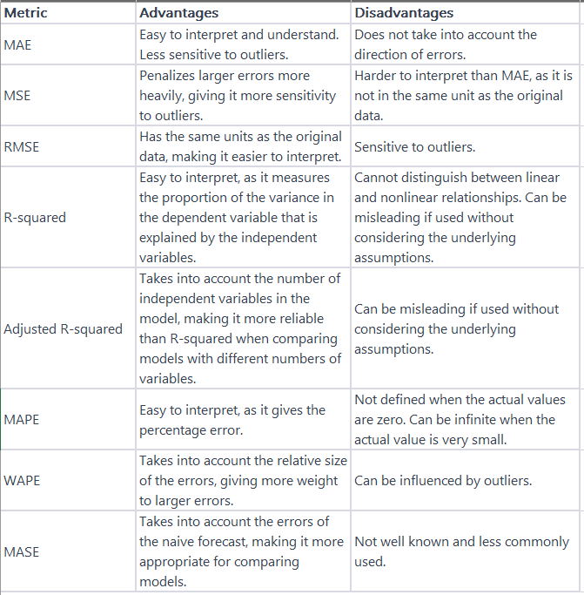
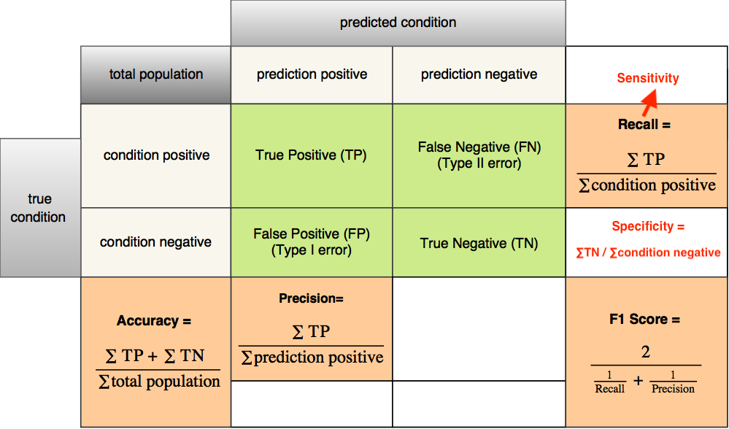
Model Evaluation
Classification
Regression

